Slide 1
Temporal Knowledge Graph
汇报人：徐文杰
日期：2021.11.24

Slide 2
01
Background & Taxonomy
目录
02
Papers
03
Ideas

Slide 3
Background & Taxonomy
1

Slide 4
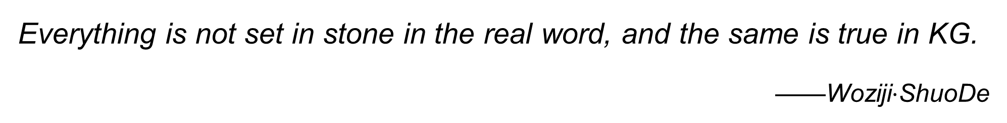
Everything is not set in stone in the real word, and the same is true in KG.
——Woziji$⋅$ShuoDe

Slide 5
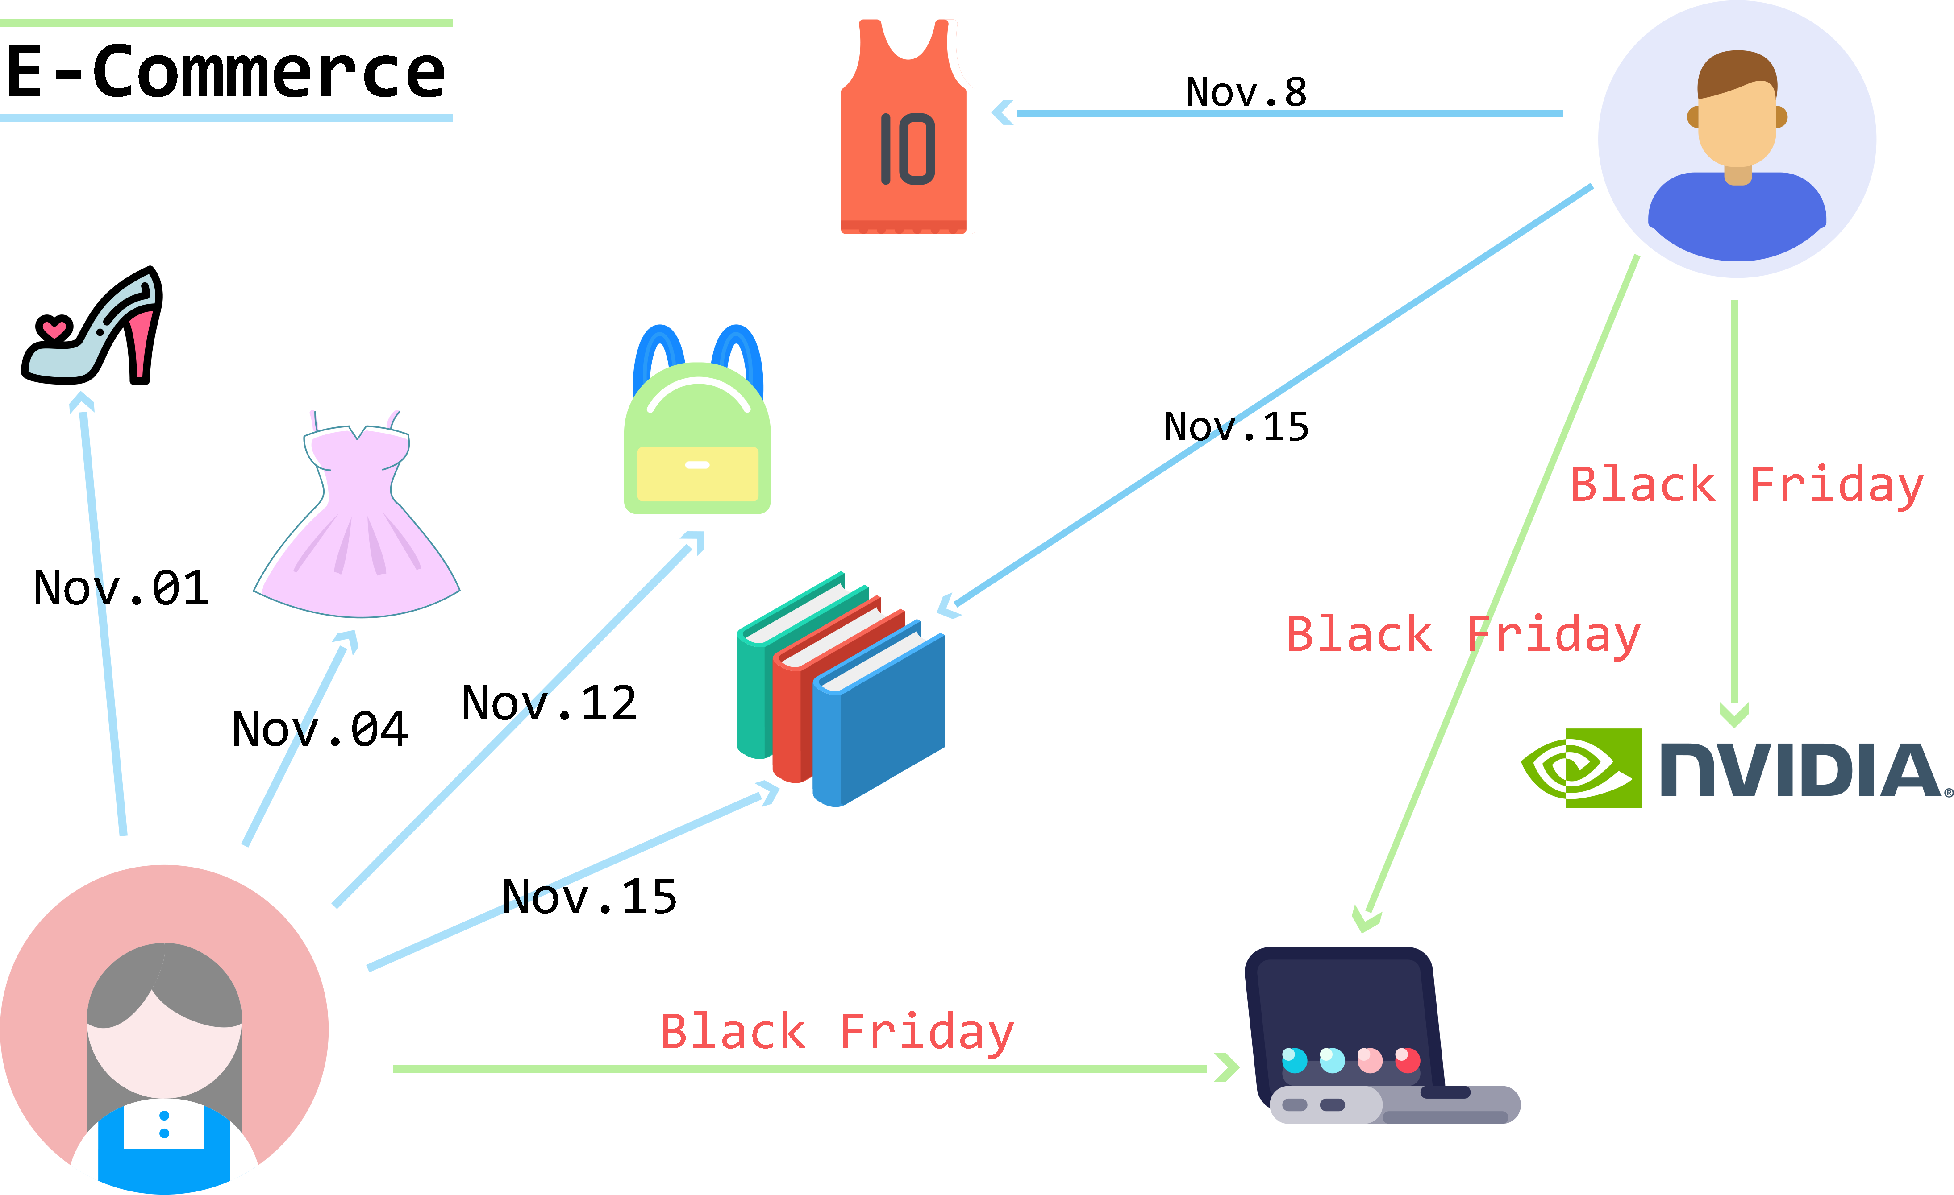
An illustration of user-item graph

Slide 6
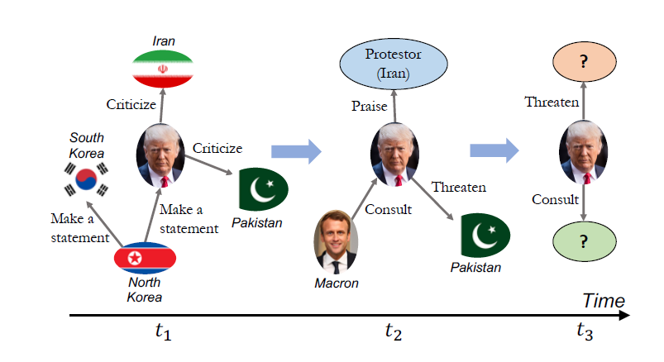
An example for Temporal Knowledge Graph

Slide 7
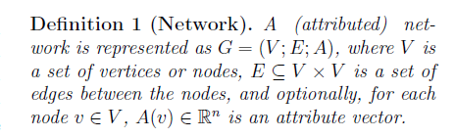
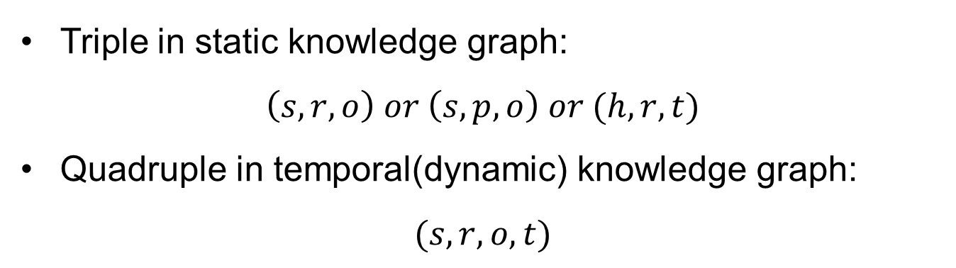
A static knowledge graph is defined as a network.
Triple in static knowledge graph:
$$\left(s,r,o\right) or \left(s,p,o\right) or (h,r,t)$$
Quadruple in temporal(dynamic) knowledge graph:
$$(s,r,o,t)$$

Slide 8
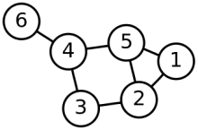
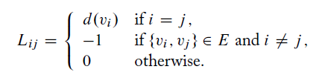
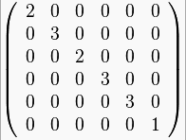
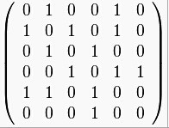
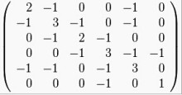
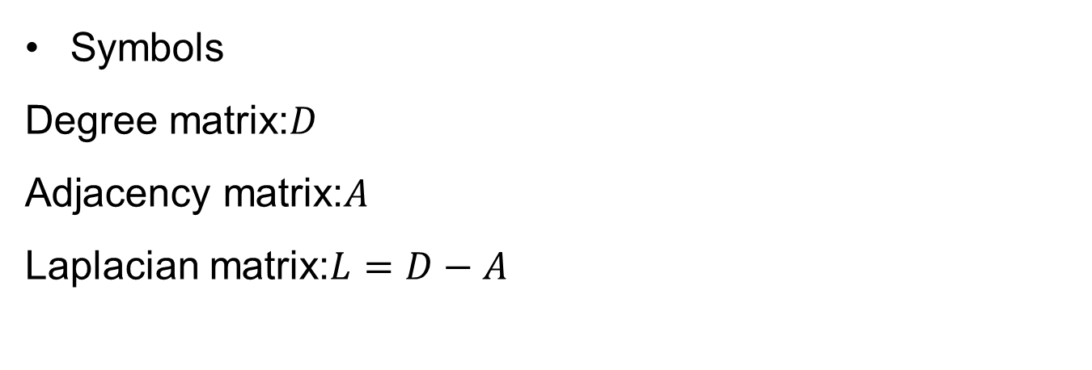
Symbols
Degree matrix:$D$
Adjacency matrix:$A$
Laplacian matrix:$L=D−A$
Degree matrix
Adjacency matrix
Laplacian matrix

Slide 9
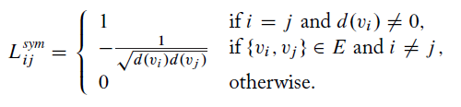
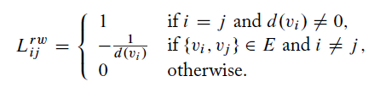
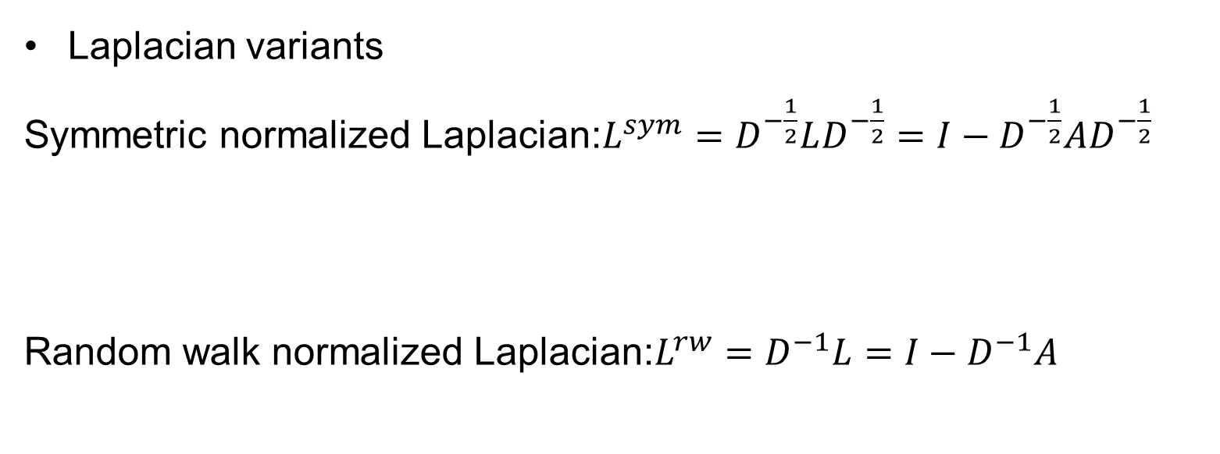
Laplacian variants
Symmetric normalized Laplacian:$L^{sym}=D^{−\frac{1}{2}}LD^{−\frac{1}{2}}=I−D^{−\frac{1}{2}}AD^{−\frac{1}{2}}$
Random walk normalized Laplacian:$L^{rw}=D^{−1}L=I−D^{−1}A$

Slide 10
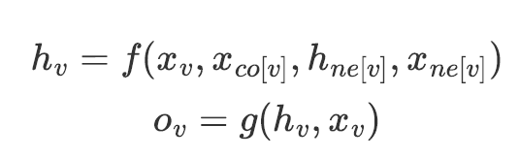
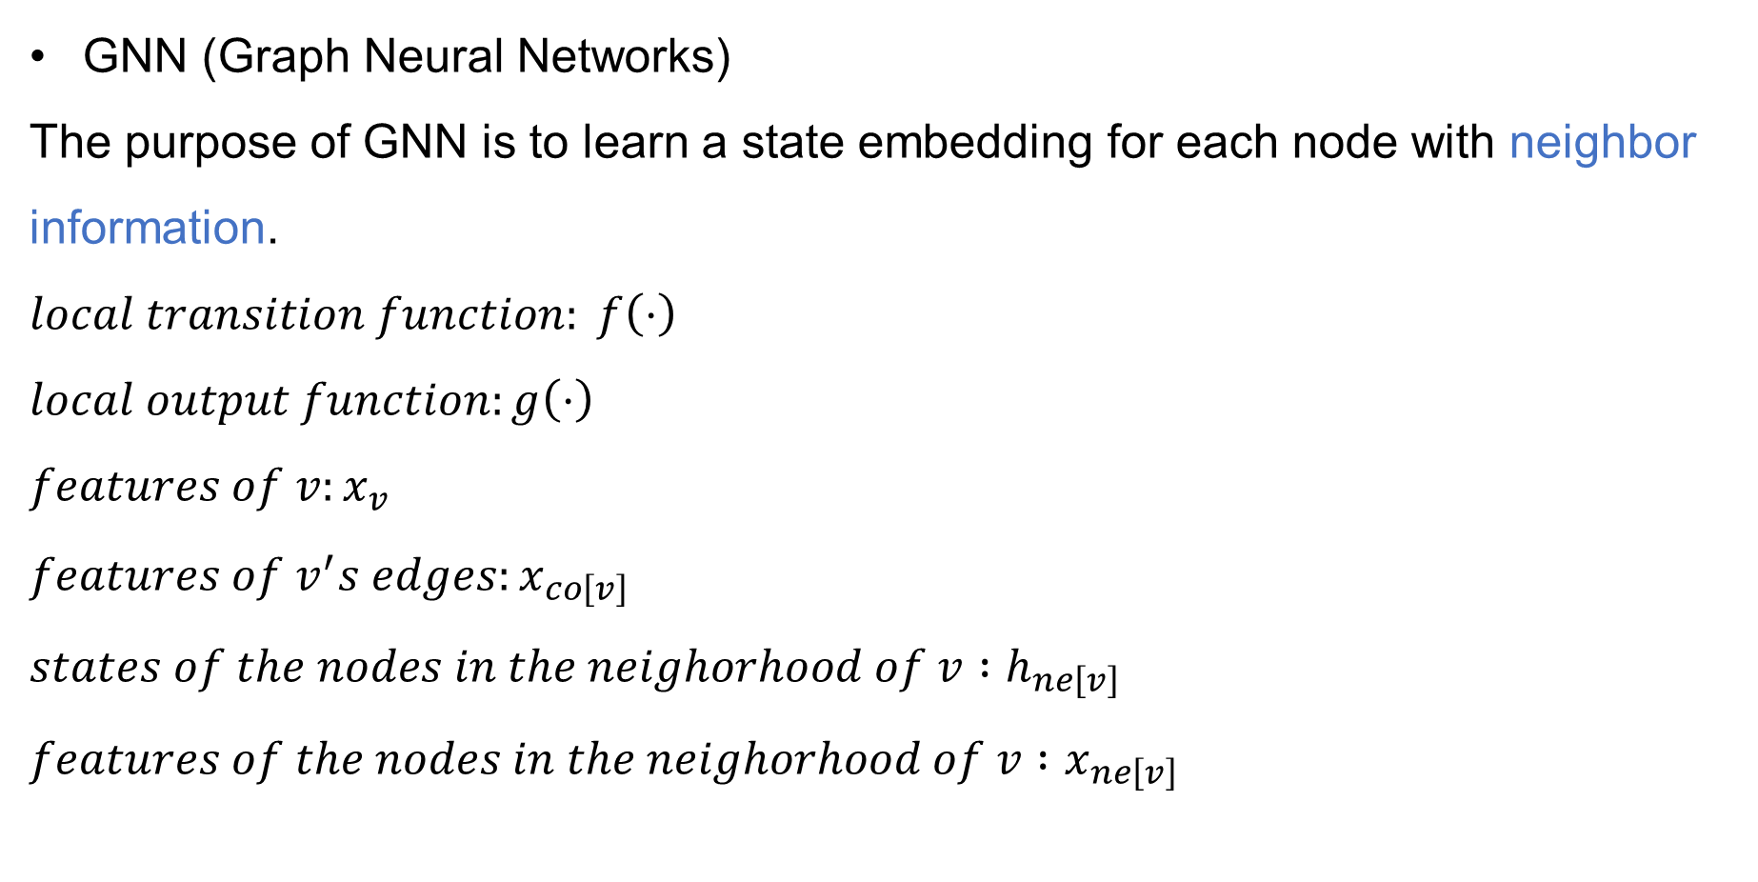
GNN (Graph Neural Networks)
The purpose of GNN is to learn a state embedding for each node with neighbor information.
$$local transition function: f\left(⋅\right)$$
$$local output function:g\left(⋅\right)$$
$$features of v:x_{v}$$
$$features of v^{′}s edges:x_{co\left[v\right]}$$
$$states of the nodes in the neighorhood of v :h_{ne\left[v\right]}$$
$$features of the nodes in the neighorhood of v :x_{ne\left[v\right]}$$

Slide 11
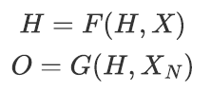
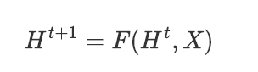
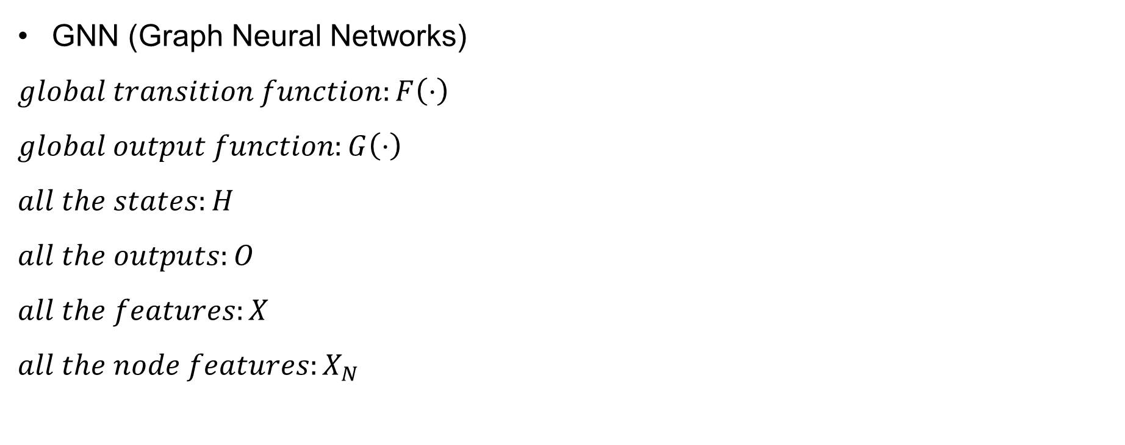
GNN (Graph Neural Networks)
$$global transition function:F\left(⋅\right)$$
$$global output function:G\left(⋅\right)$$
$$all the states:H$$
$$all the outputs:O$$
$$all the features:X$$
$$all the node features:X_{N}$$

Slide 12
Discrete Model
See a dynamic network as a sequence of network snapshots (independent and complete graphs)
An illustration of discrete model

Slide 13
Continuous Model
New edges are created and annotated with timestamps when interactions between nodes occur.
An illustration of continuous model

Slide 14
Challenges
Preserve the networks’ structure (and properties)
Nodes in the same community should have similar embeddings.
Preserve the evolution of networks in long-term
The learned embeddings should reflect the interaction with other nodes over time.

Slide 15
Structural-first model
Matrix factorization based model
Find lower dimensional matrices whose product serves as a approximation to the original matrix.
Matrix factorization based methods model dynamic network in discrete way and learn node embedding by solving generalized eigen-problem.

Slide 16
Structural-first model
Autoencoder based model
Learn embeddings by minimizing the reconstruction error.
An illustration of autoencoder mechanism

Slide 17
Structural-first model
Skip-gram based model
Skip-gram is a simple but effective model to learn embedding representations.
Skip-gram based methods are often based on random walks to design sampling methods, thereby updating the context information of the node in network evolution.
Skip-gram exhibits higher performance when the network structure changes little.

Slide 18
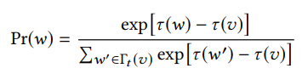
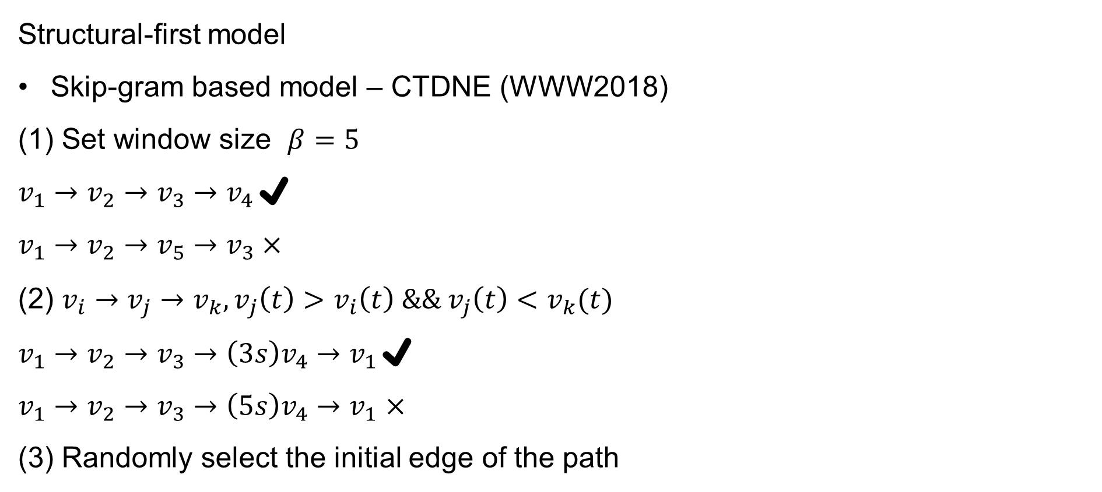
Structural-first model
Skip-gram based model – CTDNE (WWW2018)
Set window size $β=5$
$v_{1}→v_{2}→v_{3}→v_{4}$✔
$$v_{1}→v_{2}→v_{5}→v_{3}×$$
(2) $v_{i}→v_{j}→v_{k},v_{j}\left(t\right)>v_{i}\left(t\right) \&\& v_{j}\left(t\right)<v_{k}(t)$
$v_{1}→v_{2}→v_{3}→{\left(3s\right)v}_{4}→v_{1}$✔
$v_{1}→v_{2}→v_{3}→{\left(5s\right)v}_{4}→v_{1}$ $×$
(3) Randomly select the initial edge of the path

Slide 19
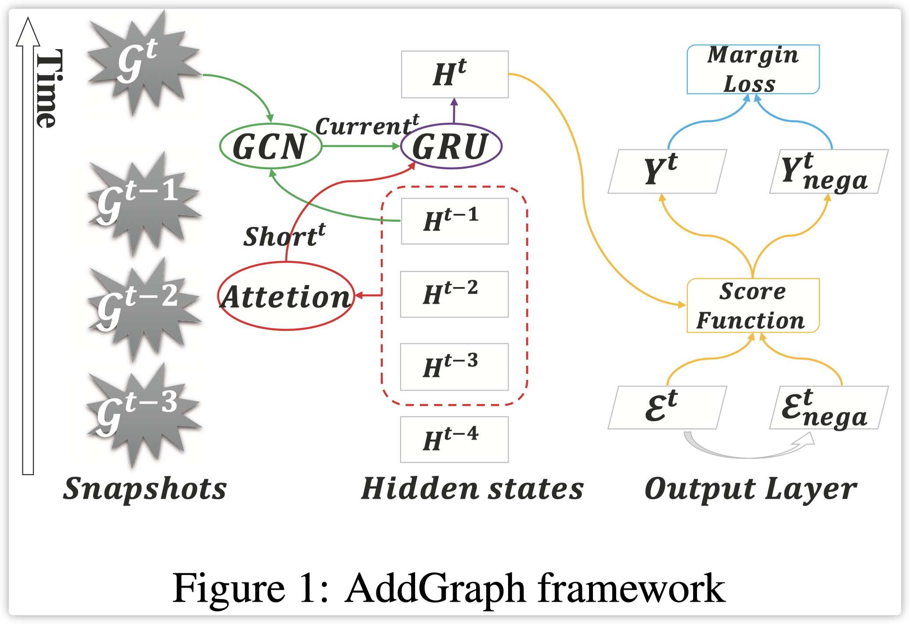
Structural-first model
GNN based model
The methods based on graph neural network can easily process attributed dynamic network.

Slide 20
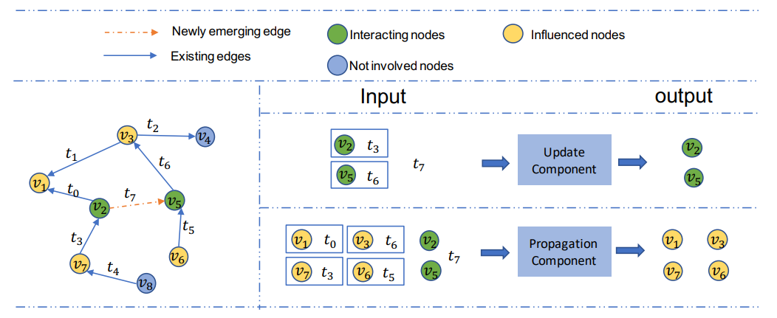
Temporal-first model
RNN based model
RNN based methods usually adopt continuous model, which can update node and
edge changes more timely.

Slide 21
2
Papers

Slide 22
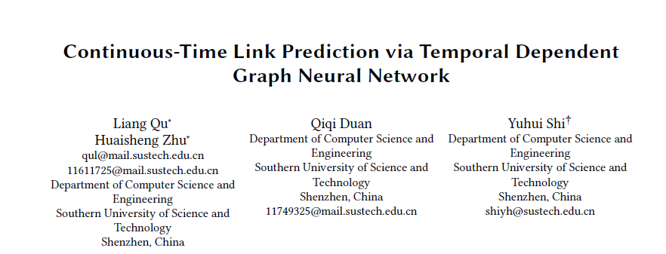
WWW 2020

Slide 23
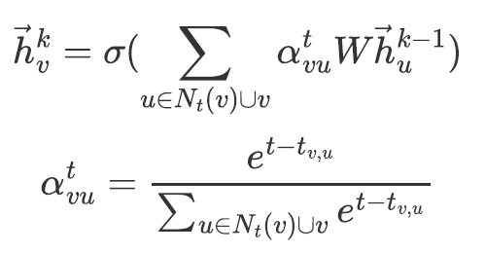
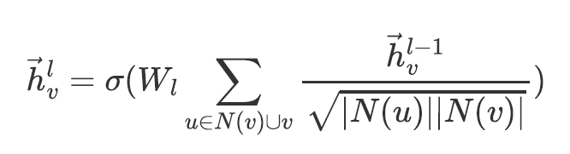
TDGNN utilized power functions to give different weights to adjacent nodes while the weights of adjacent nodes are consistent in vanilla GNN.
Hypothesis: If an edge is created earlier, the greater weight it will take when aggregating it to a node.
Vanilla GNN
TDGNN

Slide 24
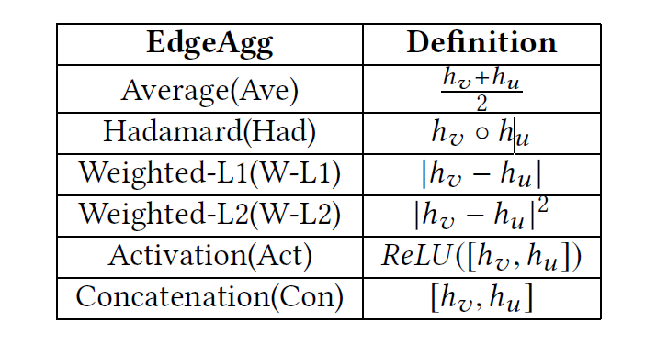
How to get edge embeddings?
The edge aggregation functions

Slide 25
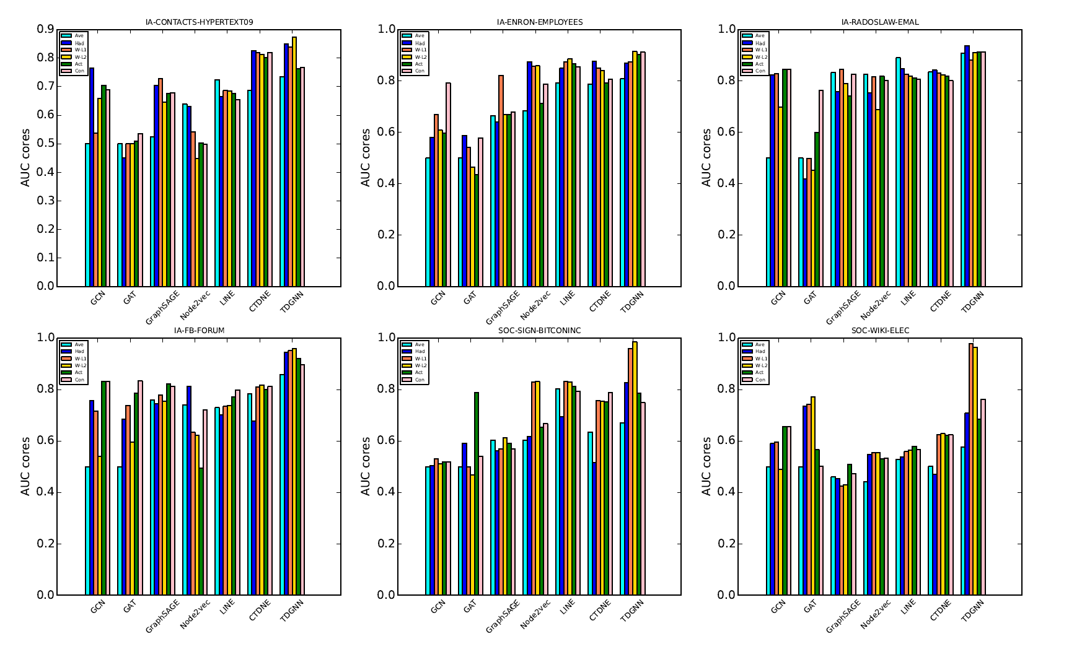
The Model Area Under Curve (AUC) Scores On Continuous-time Link Prediction Tasks with various EdgeAggs on various datasets.

Slide 26
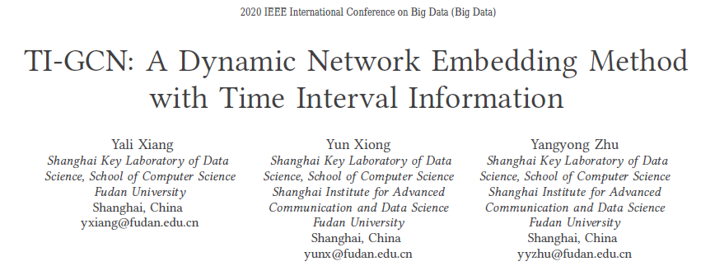
Big Data 2020

Slide 27
An eligible algorithm of learning network embeddings should have the ability to
Reflect the topology information
Capture the evolve tendency
The structural differences between the two snapshots determine the network embeddings’ developments.
To compute embedding is to compute the variation of embedding.

Slide 28
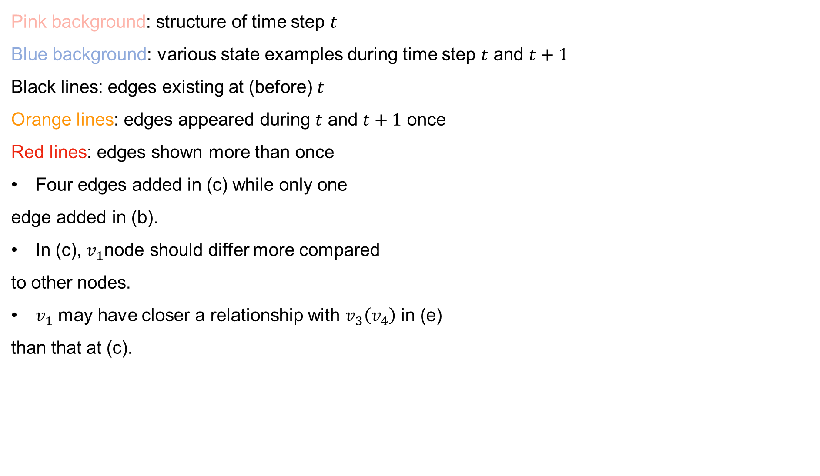
Pink background: structure of time step $t$
Blue background: various state examples during time step $t$ and $t+1$
Black lines: edges existing at (before) $t$
Orange lines: edges appeared during $t$ and $t+1$ once
Red lines: edges shown more than once
Four edges added in (c) while only one
edge added in (b).
In (c), $v_{1}$node should differ more compared
to other nodes.
$v_{1}$ may have closer a relationship with $v_{3}\left(v_{4}\right)$ in (e)
than that at (c).

Slide 29
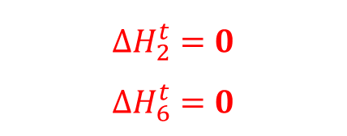
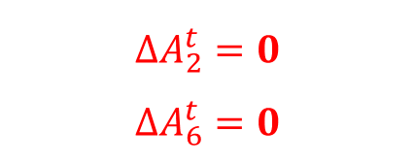
$$∆A_{2}^{t}=0$$
$$∆A_{6}^{t}=0$$
$$∆H_{2}^{t}=0$$
$$∆H_{6}^{t}=0$$

Slide 30
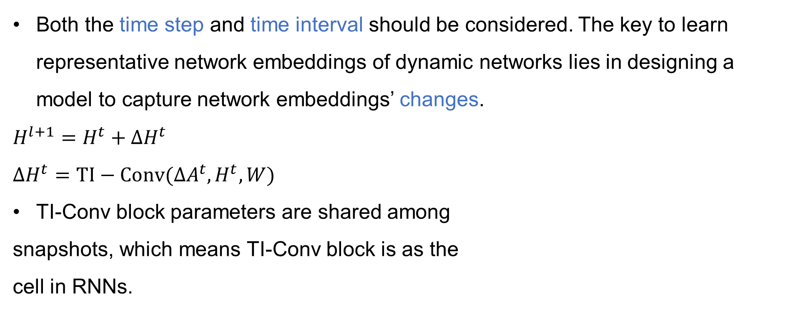
Both the time step and time interval should be considered. The key to learn representative network embeddings of dynamic networks lies in designing a model to capture network embeddings’ changes.
$$H^{l+1}=H^{t}+∆H^{t}$$
$$∆H^{t}=TI−Conv(∆A^{t},H^{t},W)$$
TI-Conv block parameters are shared among
snapshots, which means TI-Conv block is as the
cell in RNNs.

Slide 31
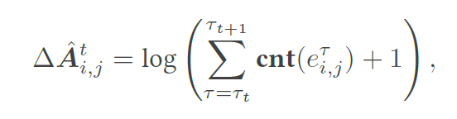
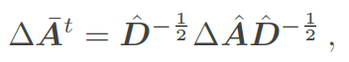
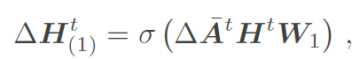
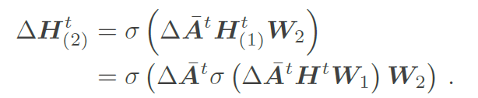
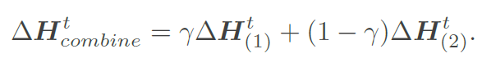
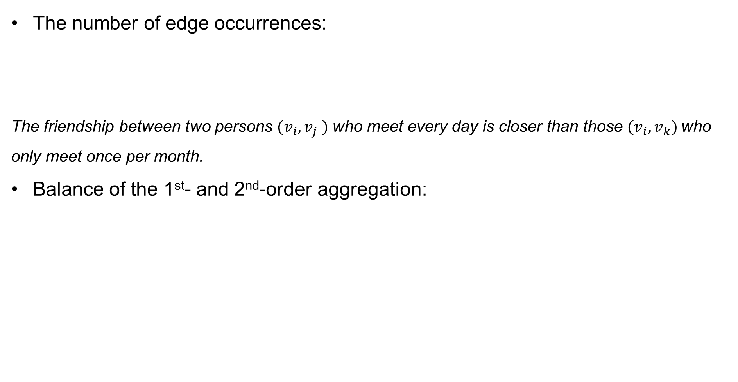
The number of edge occurrences:
The friendship between two persons $(v_{i}, v_{j} )$ who meet every day is closer than those $(v_{i}, v_{k})$who only meet once per month.
Balance of the 1st- and 2nd-order aggregation:

Slide 32
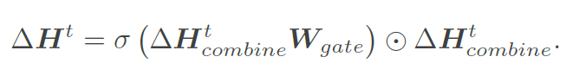
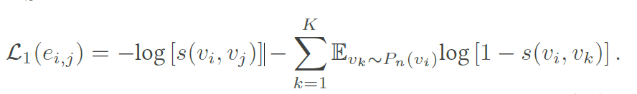
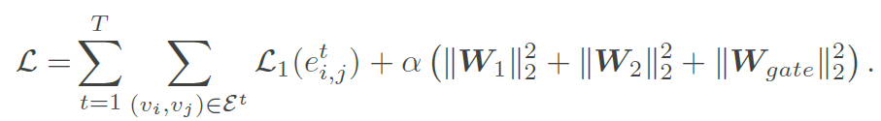
Gate Mechanism:
Control the information flow of the network embeddings sequences.
Loss Function

Slide 33
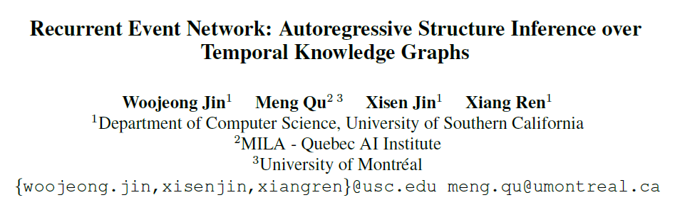
EMNLP 2020

Slide 34
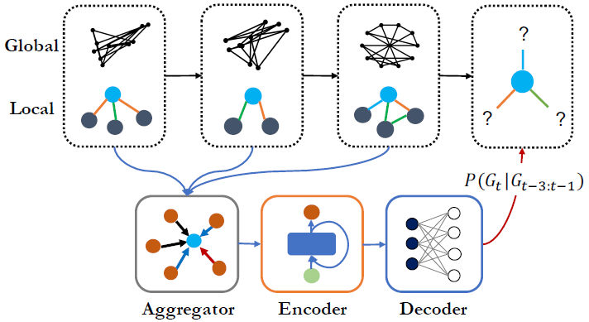
An illustration of RE-NET

Slide 35
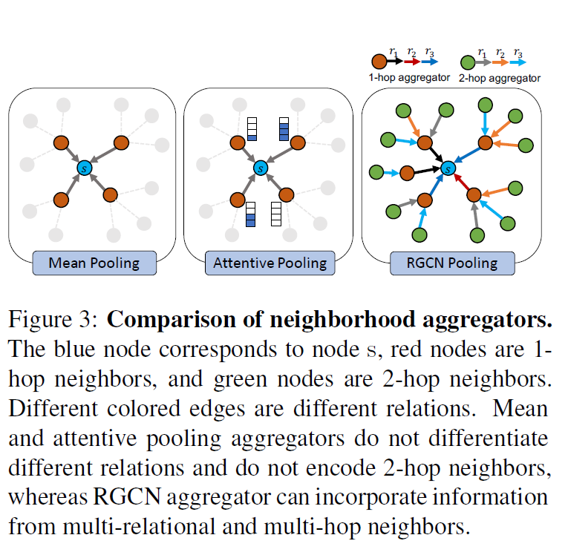
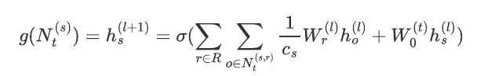
Aggregator
Multi-Relational Graph (RGCN) Aggregator

Slide 36
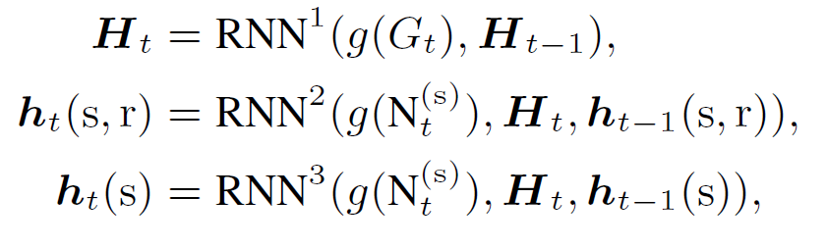
Encoder
RNN

Slide 37
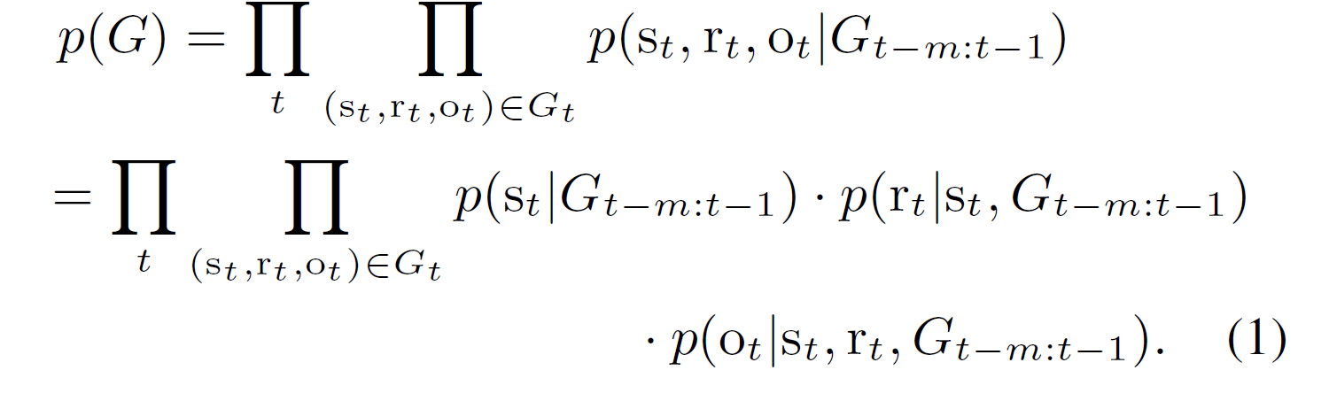
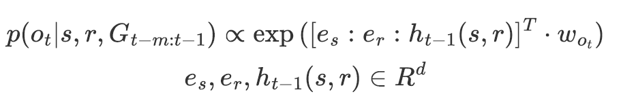
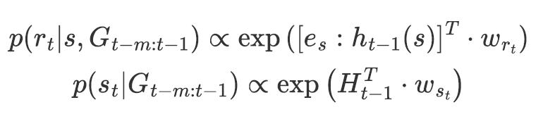
Decoder
MLP decoder

Slide 38

Loss function

Slide 39

IJCAI 2021

Slide 41

An illustration of CompGCN

Slide 42






Structural information passing (SIP)
Based on CompGCN (ICLR 2020)
K spaces
Attention
Represents the correlation of the message$φ\left(x_{r},x_{o}\right)$and k-th component of $s$

Slide 43




Temporal information passing (SIP)
$entity s:\{x_{s,t−m+1},x_{s,t−m+2},…,x_{s,t}\}$
$$s output:\{z_{s,t−m+1},z_{s,t−m+2},…,z_{s,t}\}$$

Slide 44



Scoring function
Temporal scoring function:$I_{t}$
Input: TIP
(2) Structural scoring function:$I_{s}$
DistMult:
(3) Repetitive history scoring function: $I_{h}$

Slide 45

AAAI 2021

Slide 46

An illustration of CyGNet

Slide 47


Historical vocabulary
Multi-hot vectors

Slide 48


Copy Mode
Index vector:
Scale:

Slide 49



Generation mode
Inference

Slide 50


Slide 51
3
Ideas

Slide 52
Does graph structure information really matter?
How to make better use of neighborhood information?
Does the time need to be embedded in the training process?
How to better represent the timing process?

Slide 53
谢谢

